Slide 1
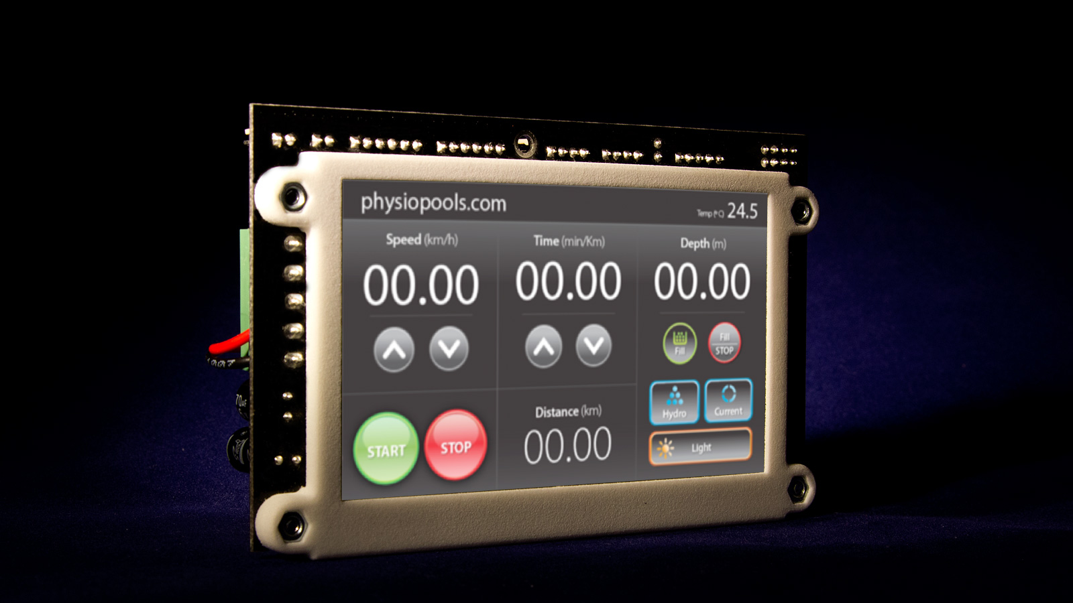
SPLat HMI430
Making touch screen based controls accessible to more OEMs
Please advance slides manually to set your own pace

Slide 2

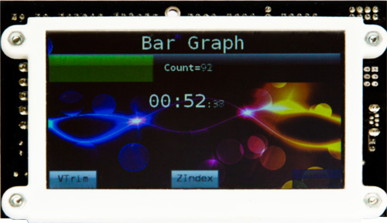
SPLat Controls
The HMI430 is SPLat Controls’ first Commercial Off The Shelf (COTS) controller with a colour touch screen. It follows from a number of custom controller designs with integral 7 inch colour touch screens.
Headline features (stacks more in tech specs!)
4.3 inch colour touch screen
Digital and analog I/O matching industry standard sensors and actuators
Bare board form factor for tight integration into OEM’s product
2

Slide 3
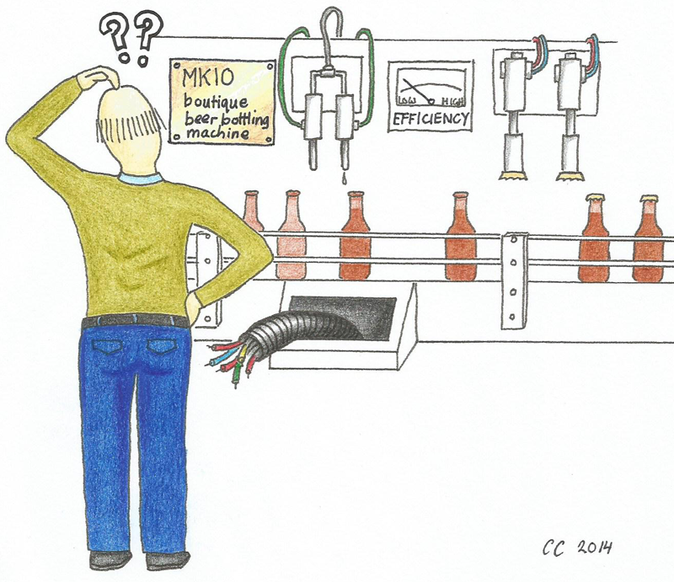
SPLat Controls
What choices does an OEM have?
(why SPLat is often the best choice!)
Joe makes beer bottling machines. He knows bottling machines inside out. He is a mechanical wiz. Unfortunately he knows precious little about electronic controls. He doesn’t even know the basic terminology like “PLC”, “embedded controls” or maximum ratings. He doesn’t even know an ampere from a milliwatt. (But he sure knows his bottles and caps.)
So what does Joe do to get “a little computer” for his new Mk10 boutique beer bottling machine?
Read on ...
3

Slide 4
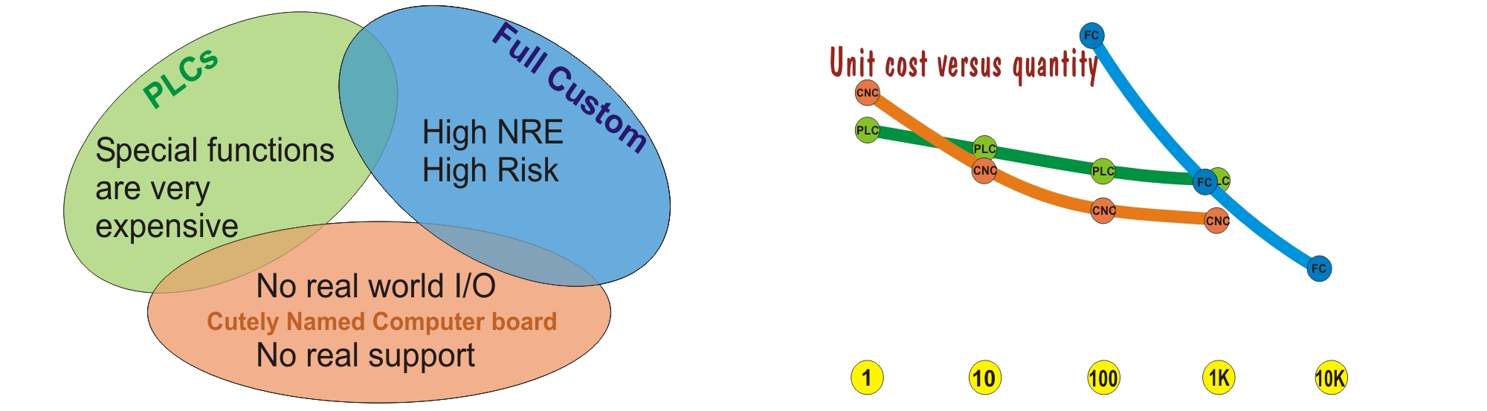
Joe
SPLat Controls
What choices does an OEM have?
If Joe’s fishing buddy is an electrical contractor, he might go for a PLC;
If Joe’s son plays with Cutely Named Computer boards, he might go for an Arduino;
If Joe’s brother is an EE with an appliance manufacturer, he might go for a custom design.
With any of these choices Joe runs some potentially expensive risks in shaping the chosen product to his real needs, and getting a reliable result with professional support. Worse, if he has to jump tracks at some point, he is faced with a complete redesign.
4

Slide 5
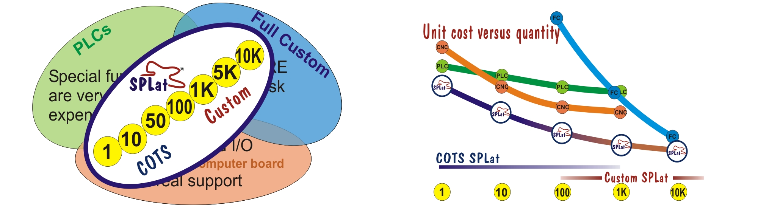
Joe
SPLat Controls
What choices does an OEM have?
If, now, Joe chooses SPLat, life will be much easier. SPLat comes in a range of COTS products for rapid prototyping and small volume production. We can make, and are prepared to make, special function add-ons in small quantities. We have been known to alter our core firmware to accommodate a customer’s special needs. And when Joe starts selling hundreds of bottling machines, we can make him a custom SPLat that re-uses all previous work, with modest NRE and zero risk. Joe gets to go fishing more often, hang out with his son and drink a boutique beer with his brother.
Best of all, we support our customers with proactive guidance on configuring the optimum control system, programming, system integration and help with regulatory approvals. A SPLat customer is never on their own.
5

Slide 6
What other company can offer all that?
6

Slide 7
A clear, uninterrupted path from prototypes and small volume manufacture through to thousands per year, using proven technology from a professional company with a solid track record for over 30 years.
7

Slide 8
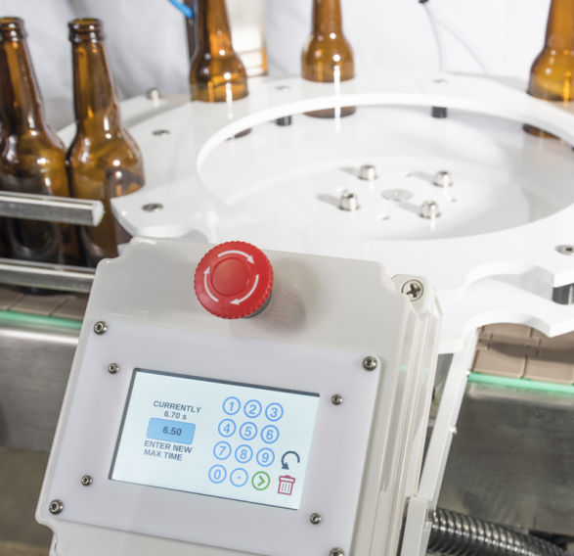
SPLat Controls
Back to the HMI430
The HMI430 will make it a lot more feasible for OEMs like Joe to put a colour touch screen into his product at an affordable price*. At a fraction of the cost of other touch screen solutions he gets a smart multitasking controller complete with proper I/O (not just wimpy 3.3V chip pins), a load of useful technical features, a range of add-on boards for expansion and special functions, and willing, competent support from a team of professionals with decades of background in embedded controls.
What more could Joe wish for?
* Actually, Joe already did. Joe is really Simon in New Zealand, an early adopter and very capable user.
8

Slide 9
SPLat Controls
Who are we?
Since 1981 SPLat Controls has been enabling OEMs in Australia and world-wide to incorporate sophisticated electronic control systems into their products. We specialise in assisting companies who lack in-house electronics expertise to get the best possible performance and value in their electronics, to make their products more competitive.
Our customers range from giants like Carrier to one man outfits making niche market specialized machines. Our best fit is with small to medium sized companies who can benefit most from our expertise and our capacity to produce electronics cost effectively in small and medium volumes.
9

Slide 10
SPLat Controls
What we offer
Our Commercial Off The Shelf, or COTS, range of SPLat products is suitable for proof of concept work, rapid prototyping, and low volume production.
But the our ultimate offering is custom designed controllers based on the same proven SPLat VM controller technology as our COTS products.
A customer can do early work on COTS product, then migrate to a custom SPLat when the time is right, with almost total code re-use.
No other controls company offers that kind of migration path.
10

Slide 11
SPLat Controls
Can we help you?
If your product needs a smart control, at an affordable price, with the best support, then go ahead, contact us!
splatco.com
11

