Slide 1
PID control basics - Bruce Varley (PCM p/l)
Essentials of loops and control
Control algorithms
The PI algorithm and its responses
Basic characteristics of controlled equipment
Closing the loop around PI control
  Limitations of P only control
  Stability
  Effect of adding I control
How to adjust settings
What about D?
DIY
A taste of more advanced techniques (Not included here)
A look at PID in the real world (Not included here)

Slide 2
Disturbance
(headwind)
Actual
(Speedo)
-
Control algorithm
(driver)
Error
Handle
(Accelerator)
+
Error = Target - Actual
Target
(60 K)
BASIC FUNCTION OF CONTROL ALGORITHM
Adjust Handle to make Error zero, ie…
Target = Actual
BASIC CONTROL LOOP: Speed control

Slide 3
Actual
-
Control algorithm
Process
(car)
Handle
+
CONTROLLER
Target
Actual
CONTROLLER
Output to handle
Target
Function of the CONTROLLER is to adjust the OUTPUT so that ACTUAL = TARGET

Slide 4
ʃ
P
Actual
Proportional
+
Error
ʃ
+
Output (P+I+D)
-
I
+
+
Integral
Target
D
Derivative
CLASSIC PID CONTROLLER

Slide 5
Actual
Integral
ʃ
I
+
+
Error
Output (P+I)
-
+
P
Target
Proportional
PI CONTROLLER

Slide 6
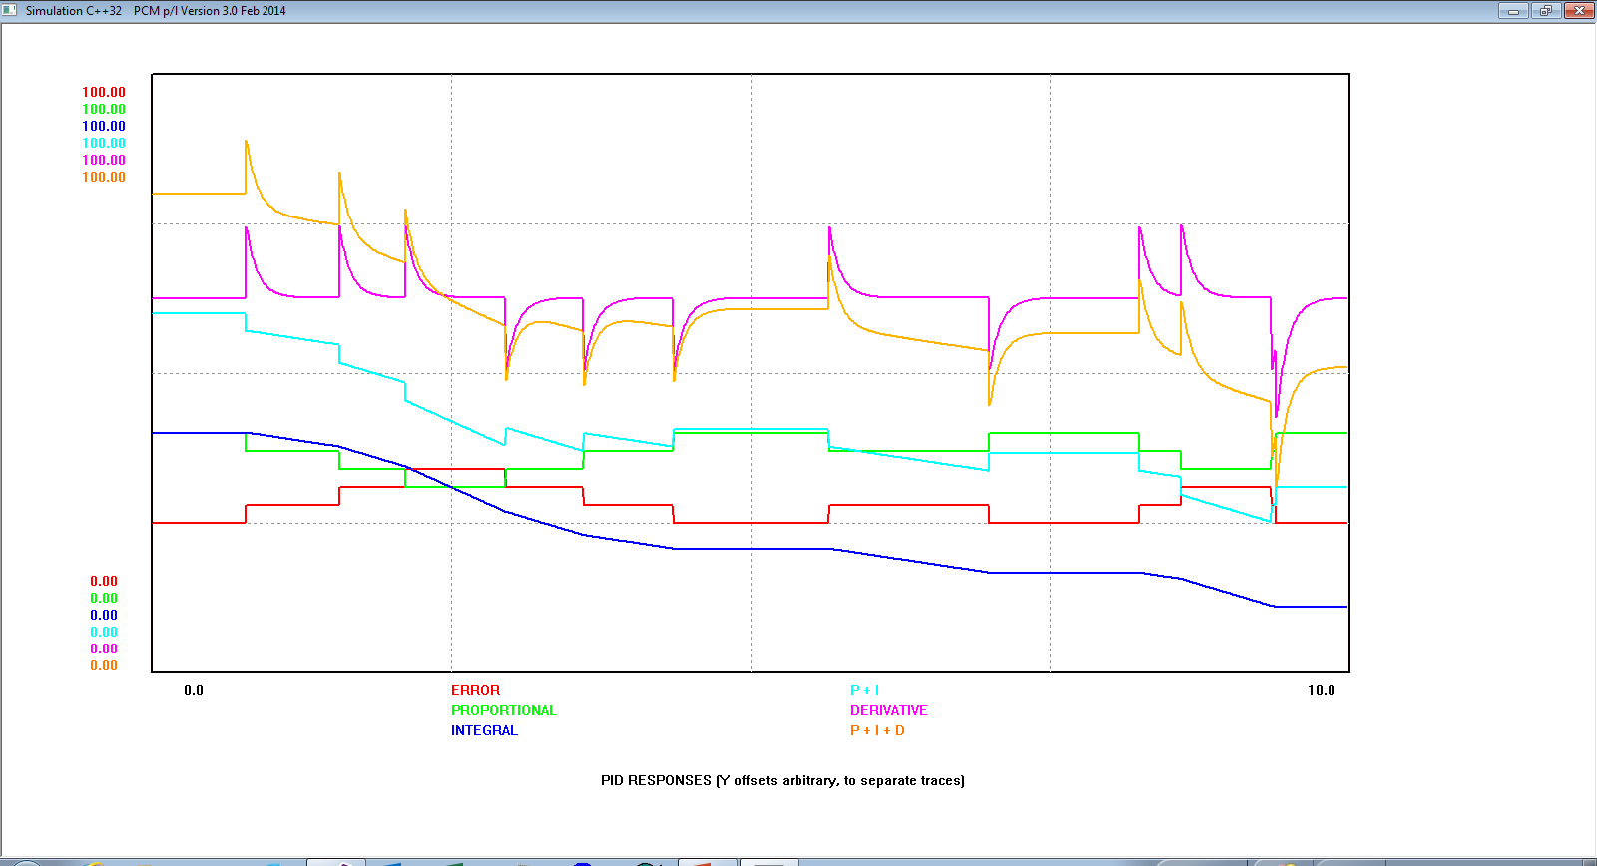

Slide 7
PI CONTROL RESPONSE ELEMENTS
The PID algorithm responds to ERROR = Target - actual
P – “Proportional”
Move in opposite direction to error
If error is steady, so is the P control action
Move magnitude (aggression) is proportional to GAIN (K)
Won’t completely eliminate error
I – “Integral”
Ramp in opposite direction to error
Moves as long as there is a non-zero error
Setting is ‘Integral time’ : Higher = LESS AGGRESSIVE
Capable of totally eliminating error in time

Slide 8
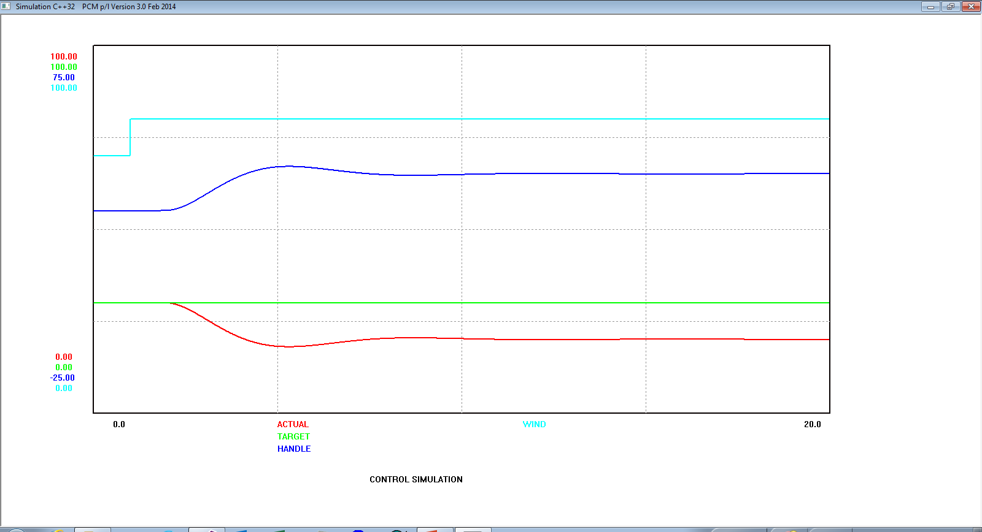
Proportional only: Note offset

Slide 9
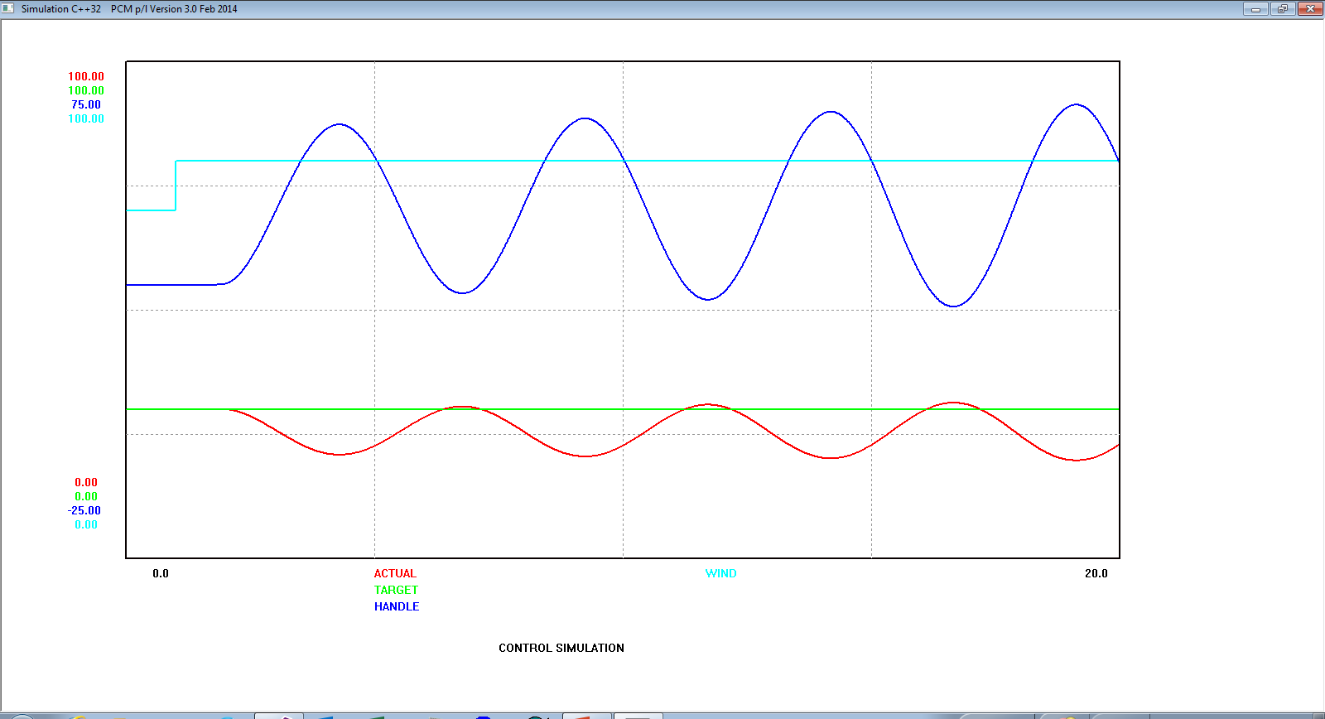
Higher gain, steady oscillation.
Note that offset still not cleared.

Slide 10
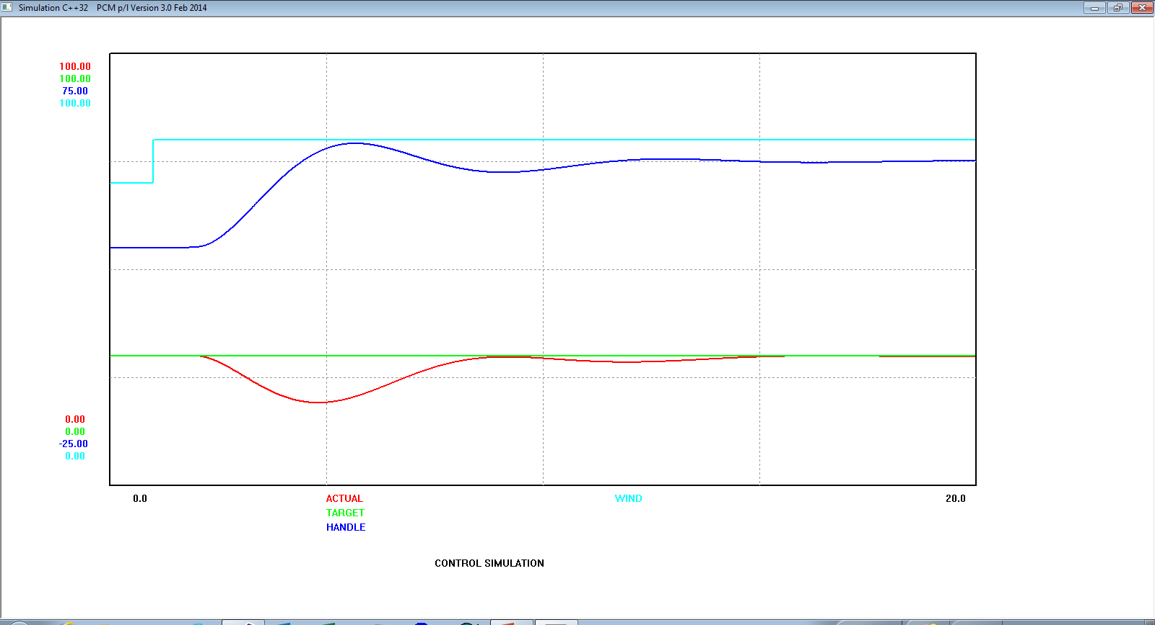
P+I control, offset effectively eliminated
This response is reasonably optimal for P+I

Slide 11
TUNING METHODS
Many different approaches, the following are just examples. Google.
‘Open Loop’.
Move the process without the loop being closed.
Characterise the response, typically on the basis of 2 or 3 numbers (depends on the method)
Use a calculation formula (eg. Ziegler-Nichols, Cohen-Coon) which will provide ‘reasonable’ settings for P, I and D.
I only needs different treatment. Usually easiest to just adjust for an OK response.
‘Closed loop’
Set the system up in closed loop to oscillate steadily with P control only.
Measure the oscillation period, and note the proportional gain.
Use a calculation formula (eg. Ziegler-Nichols, Cohen-Coon) which will provide ‘reasonable’ settings for P, I and D.
Trial & error. Can work as well as the formal methods, with less effort, if derivative not used.
Adjust for a ‘reasonable’ response with P only (slight overshoot)
Halve the P gain, insert I until slight overshoot reappears.

Slide 12
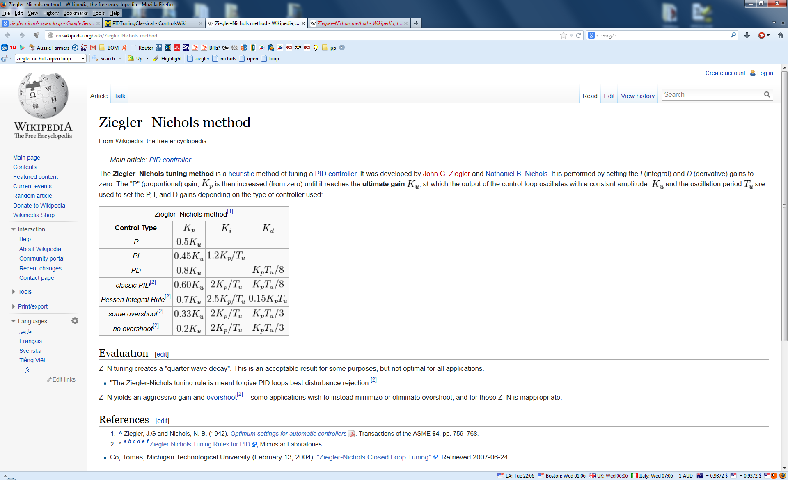

Slide 13
DERIVATIVE
Control action based on rate of change.
Can create a tighter, faster response.
Things are easier if it’s omitted (just use PI control)
  Troublesome to adjust
  Improvement may not be all that great
‘Classical’ derivative (d/dt) creates some issues. Alternative approximate algorithms are usually applied in practice.
  Avoid drastic (theoretically unbounded) moves for step changes.
  Often applied only to ‘actual’ controller input, not the target (but apply to both where fast response to target changes is required).

Slide 14

Integral
ʃ
Actual
+
Error
Proportional
+
+
Output (P+I+D)
-
P
+
Target
D
Derivative
CLASSIC PID CONTROLLER

Slide 15
Mixing & matching terms
P only. Usable if gain can be set high enough to reduce offset error sufficiently without instability. Often used for simple engine governors. Good for vessel level control.
I only. Good for processes that respond faster than the system sample rate. For these, using P or D can cause troublesome instability. Not for use with integrating process, eg. Vessel levels, these will oscillate at all settings. Generally works fine on ‘common’ process types, eg. Temperature, flow, but response rate will be slower than P+I. Will always reduce offset to zero (eventually).
P+I. Best choice for general applications where response time is not particularly critical.
P+I+D. Trickier to tune, but capable of faster response.
P+D. Not used a lot, useful for integrating processes (eg. Vessel levels) with additional dynamics.
D only, I+D. Rarely if ever used. D does not produce a practically usable control response on its own. I & D partially cancel each others effects.

Slide 16
DIY PID CONTROL
Plenty of samples on the web (analog, software & tools)
You will only control to the quality of your measurement system & handle
Analog implementations can be non-trivial
  Long time constant integrators if the process is slow
  Presetting integrators is messy
Digital implementations
  If P or D used, Sample time < Process response time / 10
  If process response time very low, use I only, Ti > Sample time * 10
  Good numeric precision important. Floating point advisable
  Very high sample times (uSecs) can cause numeric problems.

Slide 17
PID CONTROL PSEUDOCODE
Begin
Ts= 100 // 0.1 second scan rate
Set initial values
Loop
Acquire Actual & Target values (may involve ADC)
Normalise inputs (typically scale to 0 – 100%, not essential, but convenient)
Perform PID calculation
Denormalise PID output to handle range (may involve DAC)
Write output to handle
Wait Ts
Repeat Loop
End

Slide 18
Actual
Integral
ʃ
I
+
+
Error
Output (P+I)
*K
-
+
Target
Proportional
PI CONTROLLER ‘Interactive’

Slide 19
Resistor
Capacitor
Think
Actual
-
1st order lag
1 / (1 + sTi)
y
+
+
x
Handle
*K
+
Target
Error
double x, y, dy
x : input
y : output
dy = (x – y) * Ts / Ti
y = y + dy
If (y > yhi) y = yhi
If (y < ylo) y = ylo
Ti = integral time
Ts = sample time.
LAG-BASED PI CONTROL

Slide 20
Derivative
Proportional + derivative
1st order lag
1 / (1 + sTd)
+
+
-
*Kd
+
Actual
P + I
CONTROLLER
Output to
handle
Target
Kd typically 4 – 6
Normally fixed
Td: ‘Derivative time’ (secs or mins)
This is the tuning parameter.
COMMON DERIVATIVE IMPLEMENTATION

